Slide 1
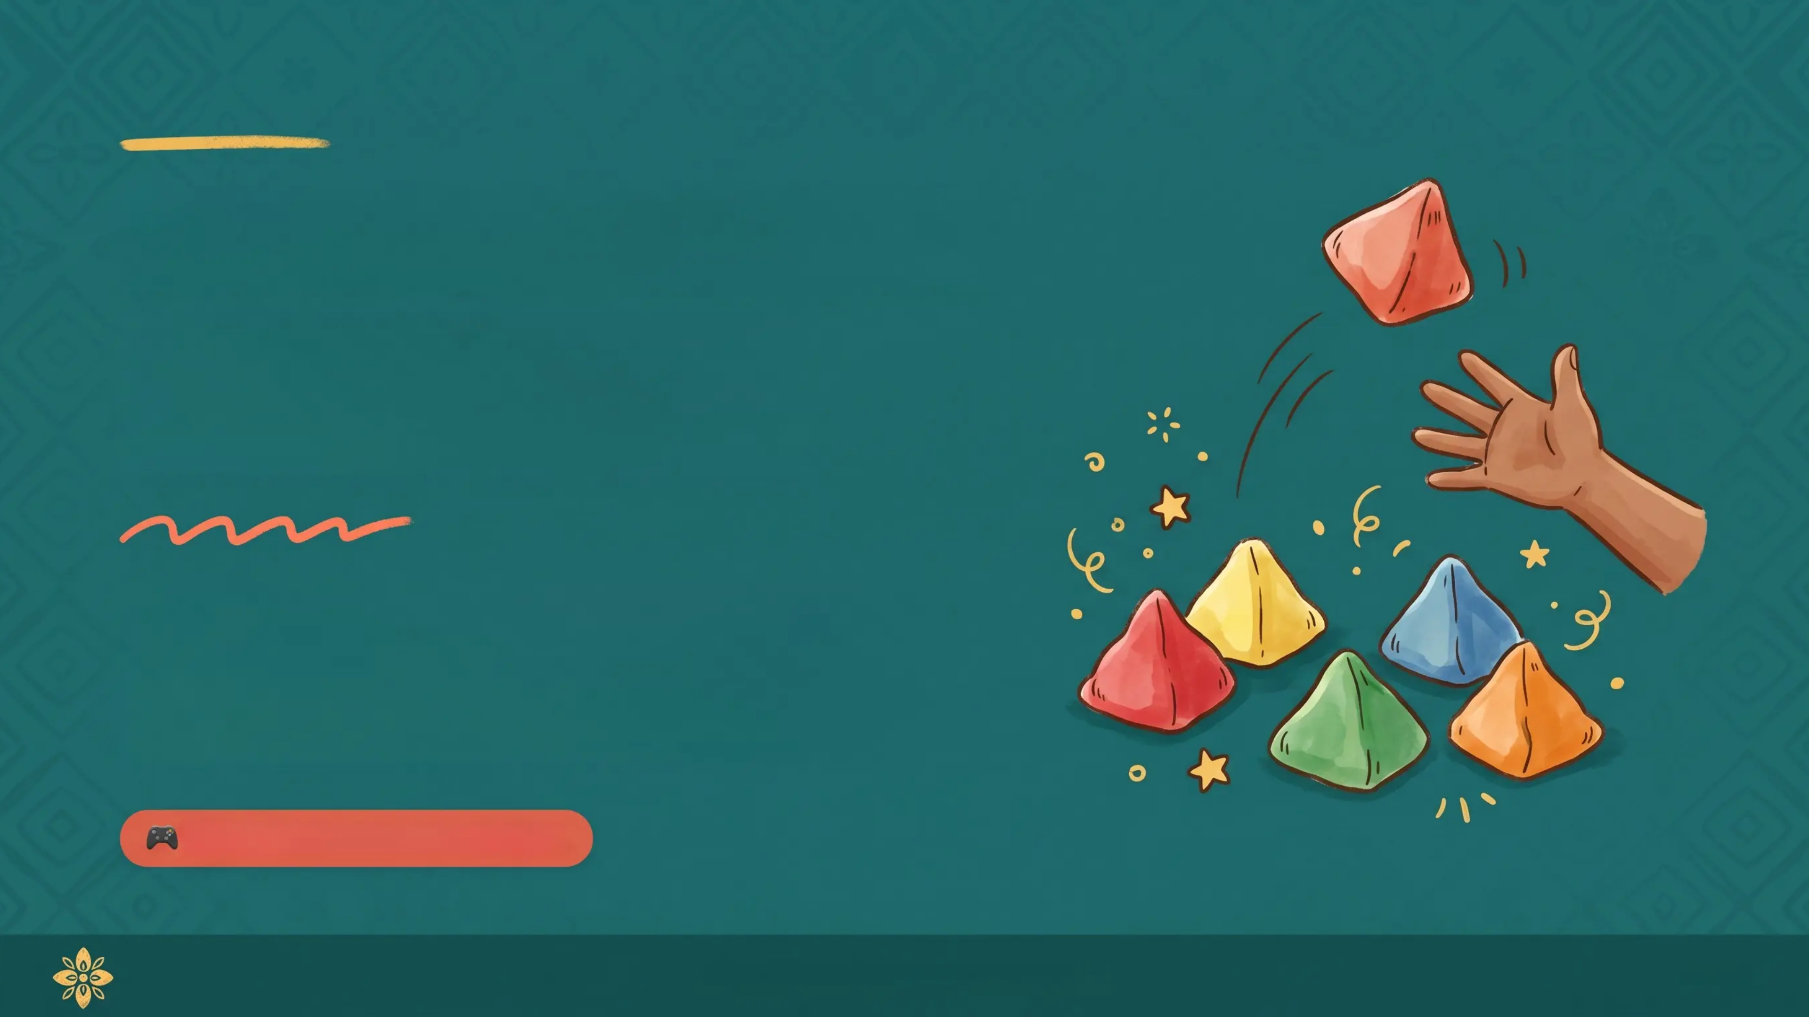
Batu Seremban
A Malaysian Traditional Game
An introduction to the beloved Malaysian traditional game known as Five Stones — focusing on dexterity, hand-eye coordination, and concentration.
🎮 Traditional Game · Malaysia
*A Game of Skill, Focus & Fun*
2026

Slide 2


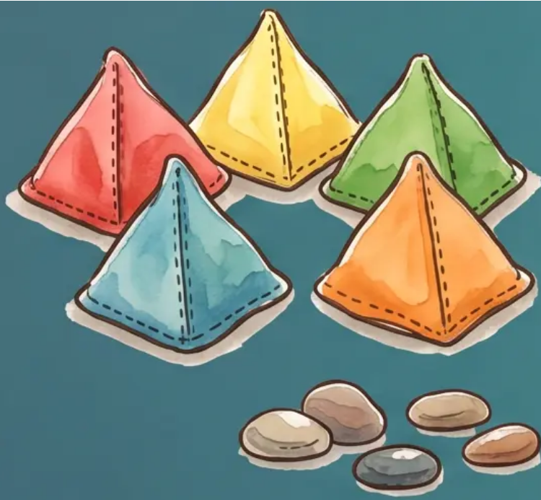
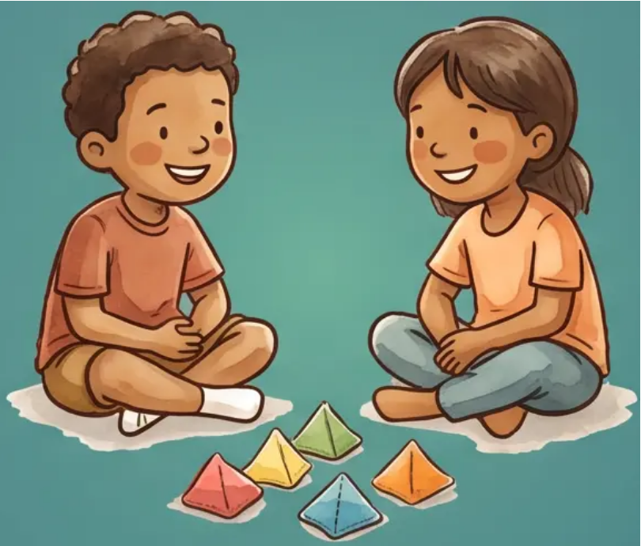
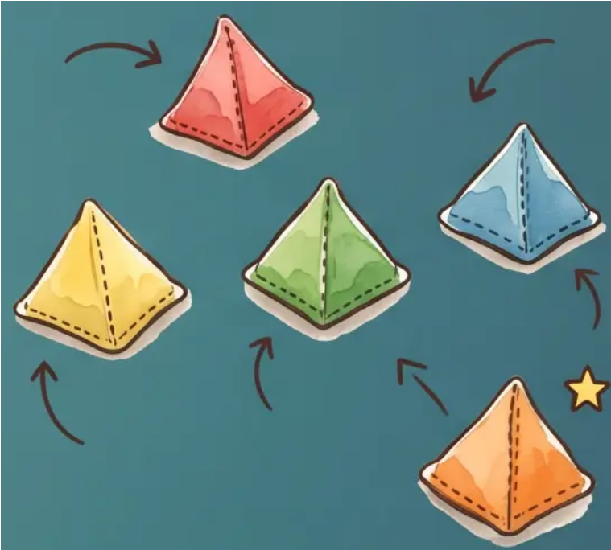


+ EQUIPMENT & SETUP
What You Need to Play
The ‘Buah’ Stones
Players
The Setup
Five small stones or pyramid cloth bags filled with beans or sand
Solo or group play — sit comfortably on the floor in a circle
Scatter the five stones gently on the ground — choose one as the tossing stone
⭐ Pro Tip: Traditional stones were found by rivers — smooth, flat pebbles fit perfectly in a child's palm! ⭐

Slide 3

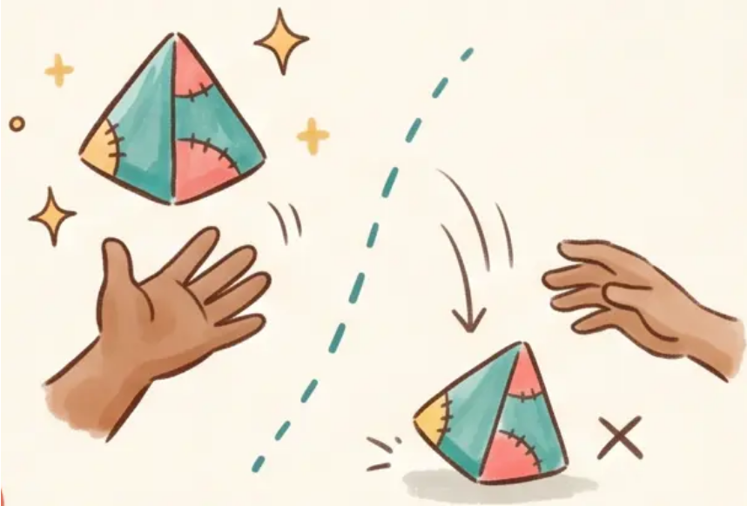


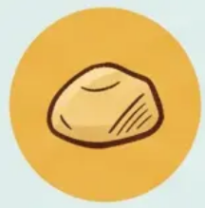
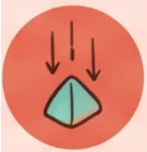
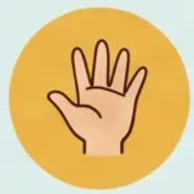
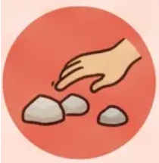
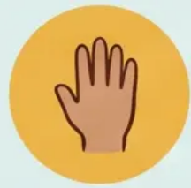
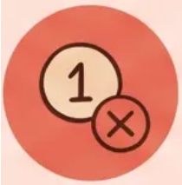

GAME BASICS
General Rules & Faults
*Know the rules. Avoid the faults. Stay in the game.*
The Core Rules
Faults — Dead Turn!
The Tossing Stone
Missed the Buah
One stone is chosen as the ‘buah’ — the stone you always toss into the air.
If the tossing stone hits the ground before you catch it — your turn ends immediately.
You Must Catch It
Touching Other Stones
The buah must always be caught before it hits the ground — every single toss.
Any unintentional movement of stones on the ground — even a slight touch — counts as a fault.
One Hand Only
Wrong Number Picked
Tossing, picking up, and catching all happen with the same hand.
Failing to pick up the exact required number of stones for that level ends your turn.
A ‘Dead Turn’ means you pass to the next player — but you resume from the same level next round!

Slide 4

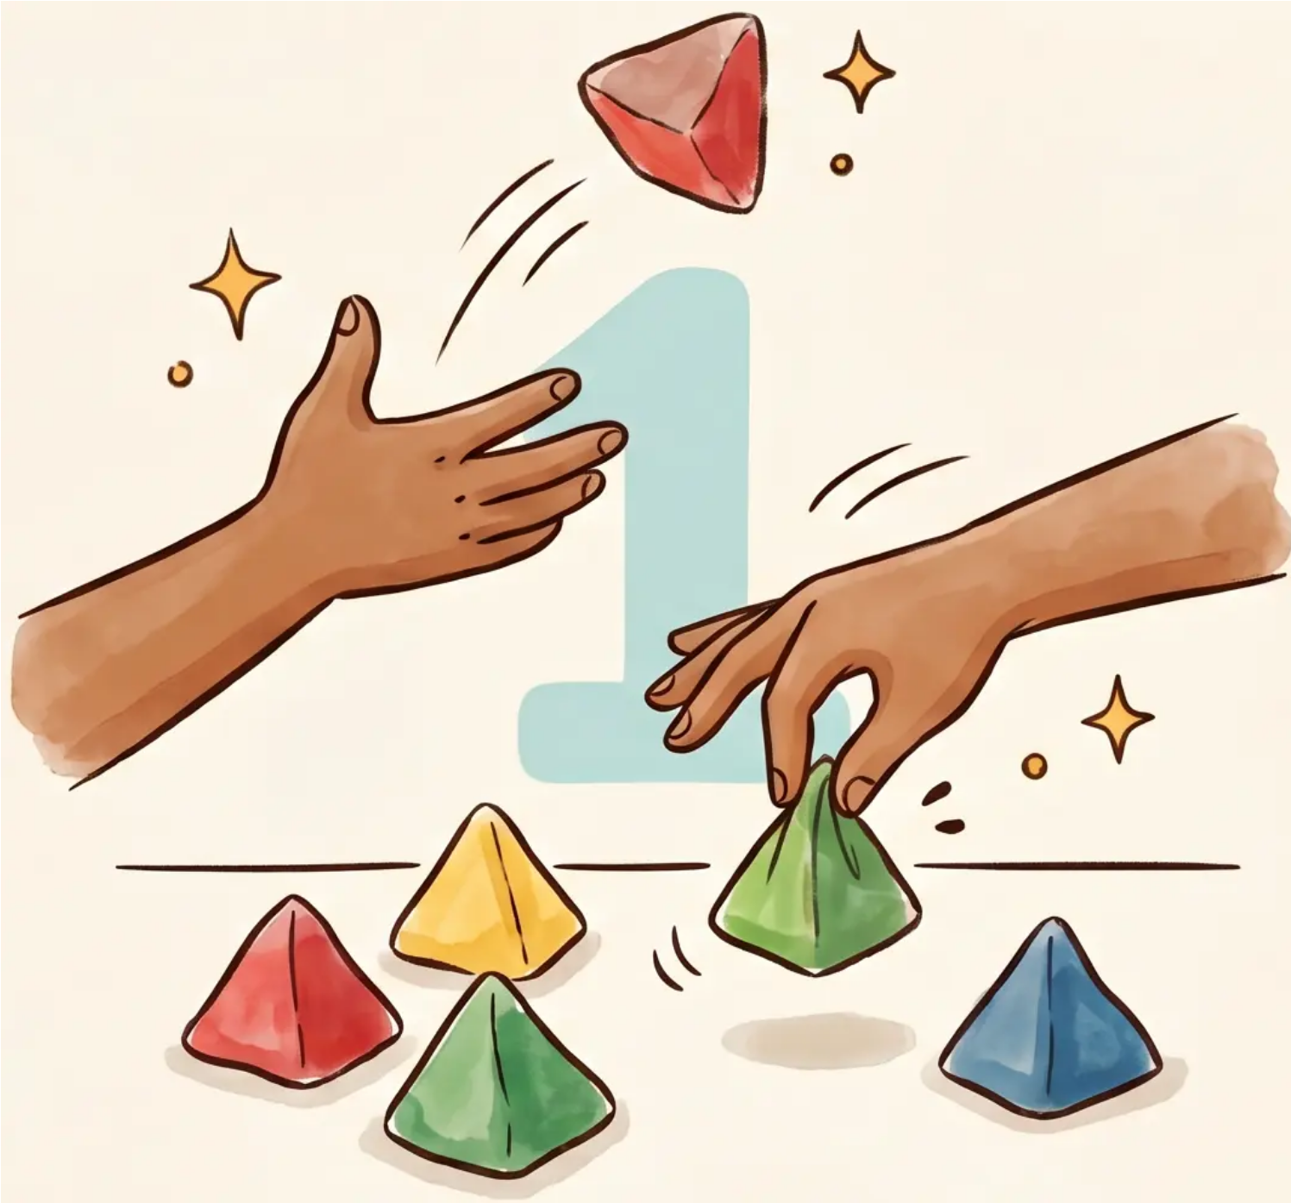

LEVEL 1
Pick One Stone at a Time
*One by One*
1
Toss the Buah
Throw the tossing stone straight up into the air
2
Grab One Stone
While the buah is airborne, quickly pick up exactly one stone from the ground
3
Catch the Buah
Catch the tossing stone before it hits the ground — using the same hand
🔄 Repeat until all four stones are gathered, one at a time
*Batu Seremban
4 / 10

Slide 5
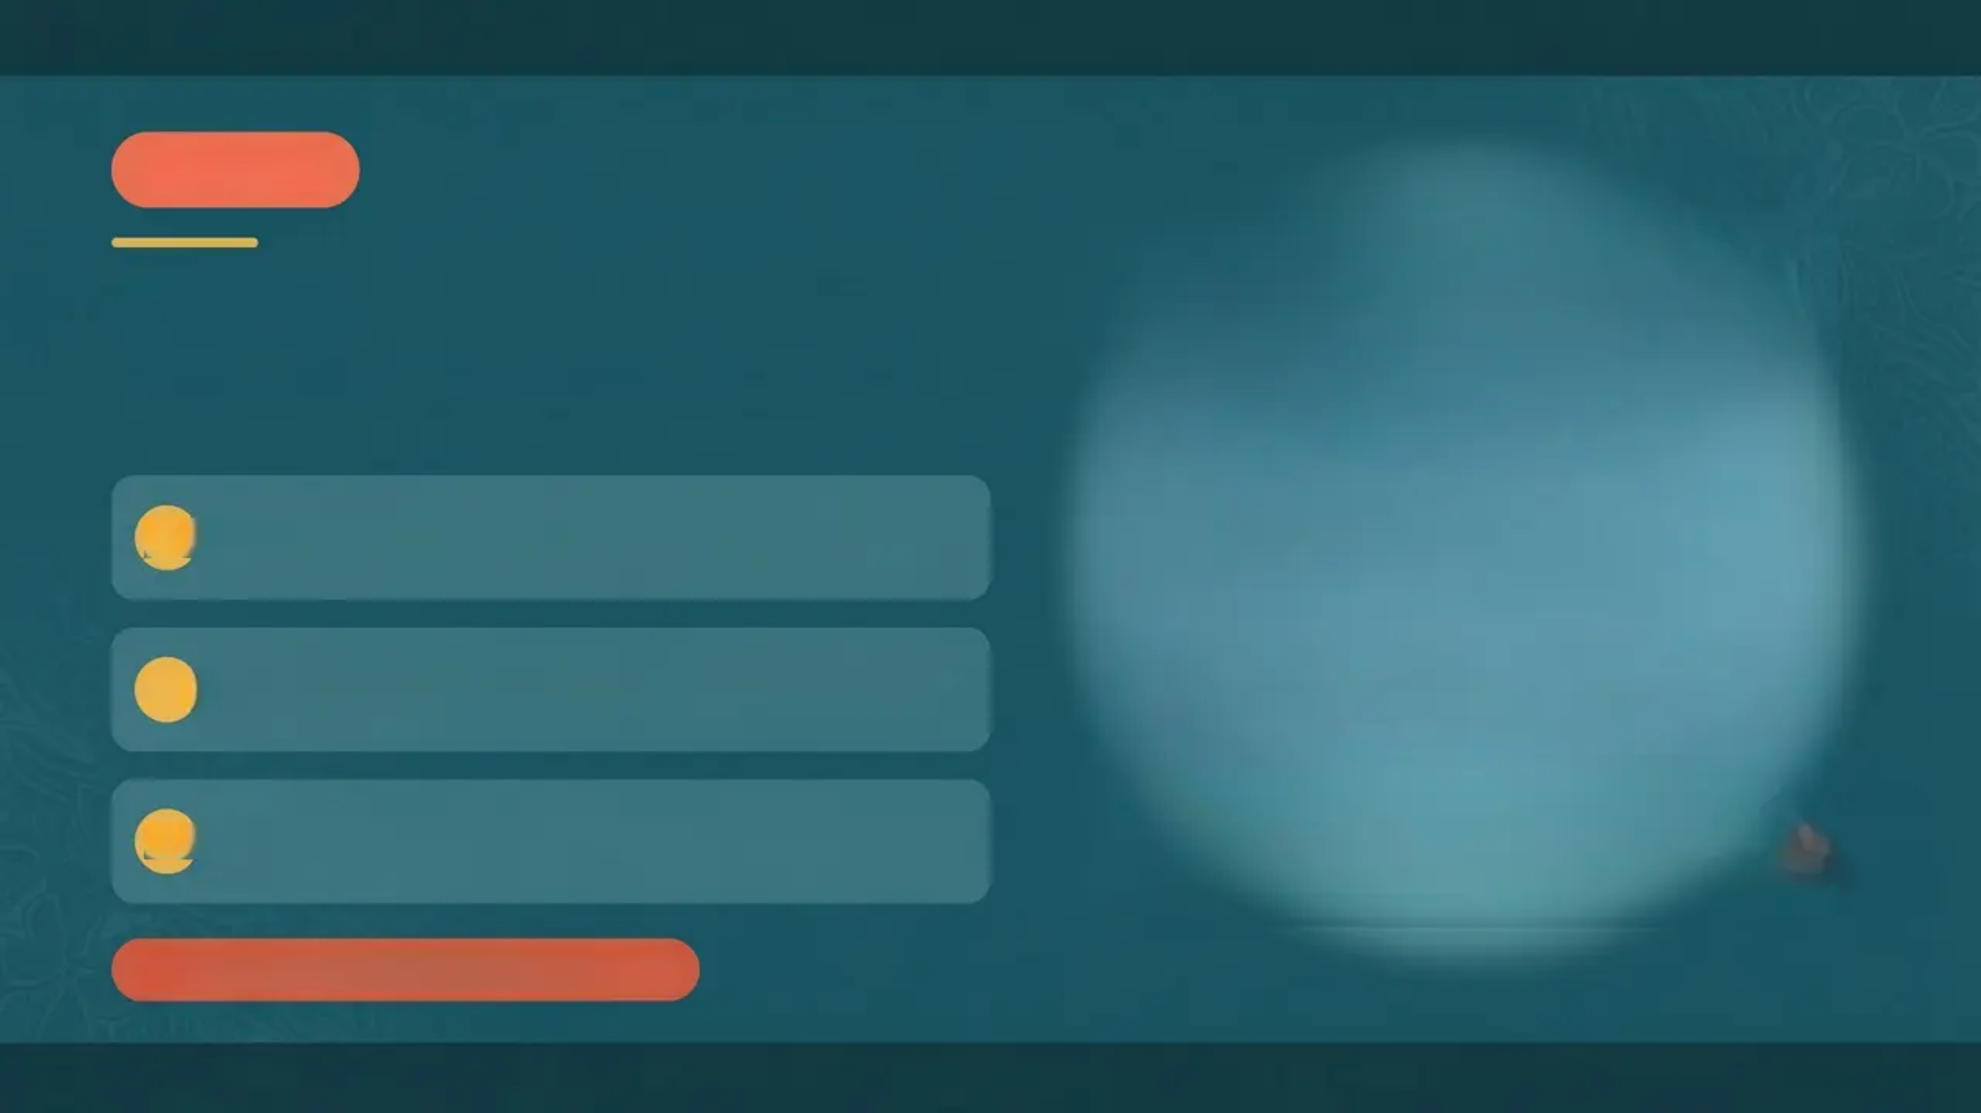

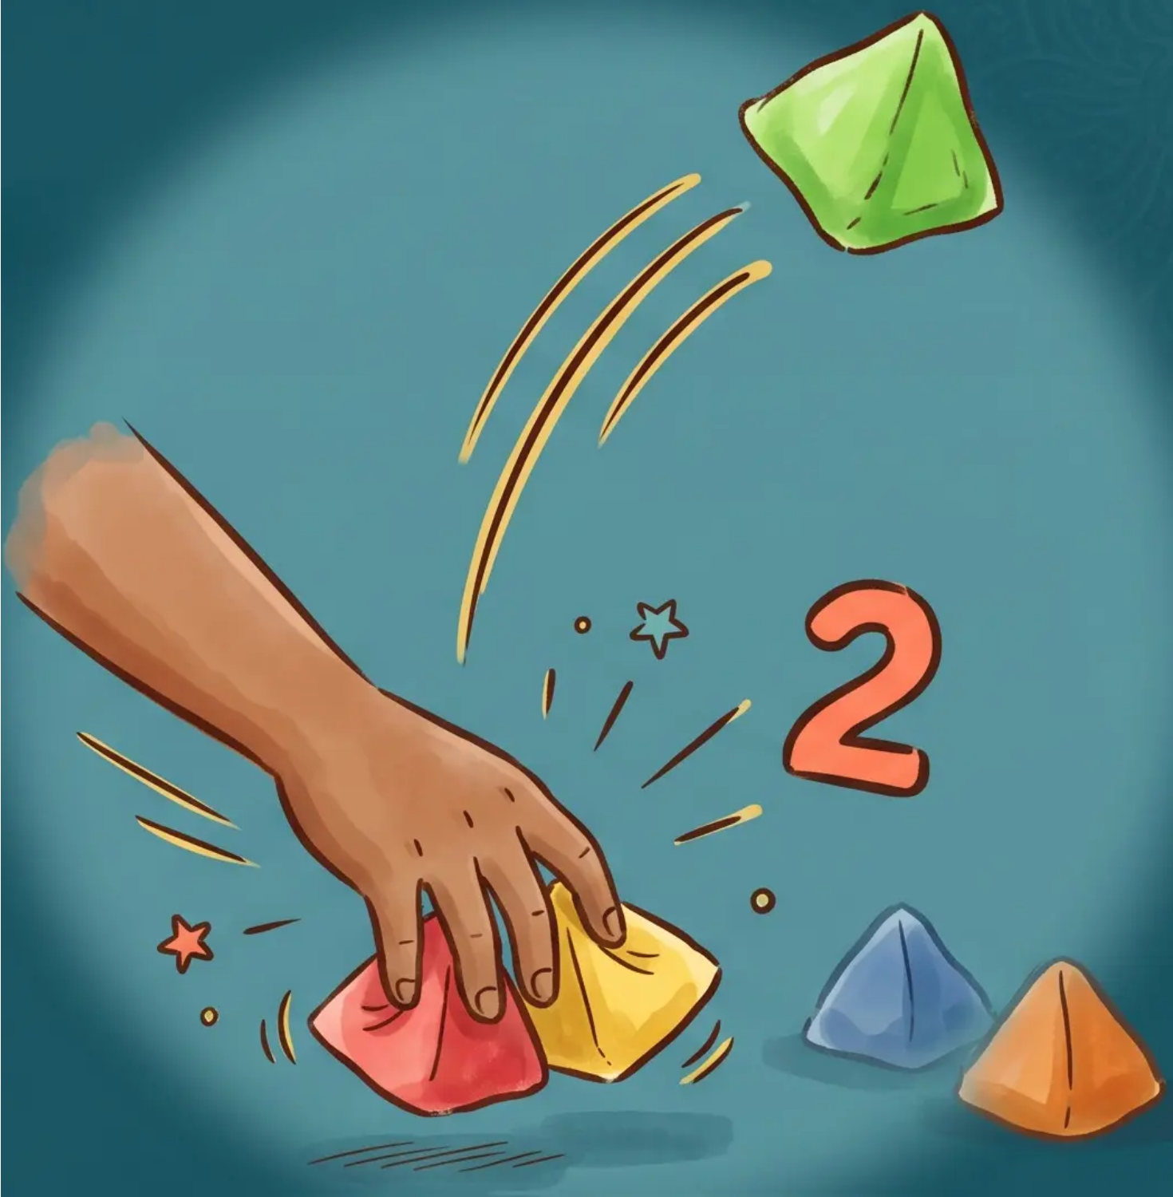

*Batu Seremban
LEVEL 2
Pick Two Stones at a Time
One swift motion — twice the challenge!
1
Toss the ‘buah’ upward into the air
2
Grab two stones from the ground in one motion
3
Catch the ‘buah’ before it lands — same hand!
Touching other stones = Dead Turn
*Level 2 of 5

Slide 6
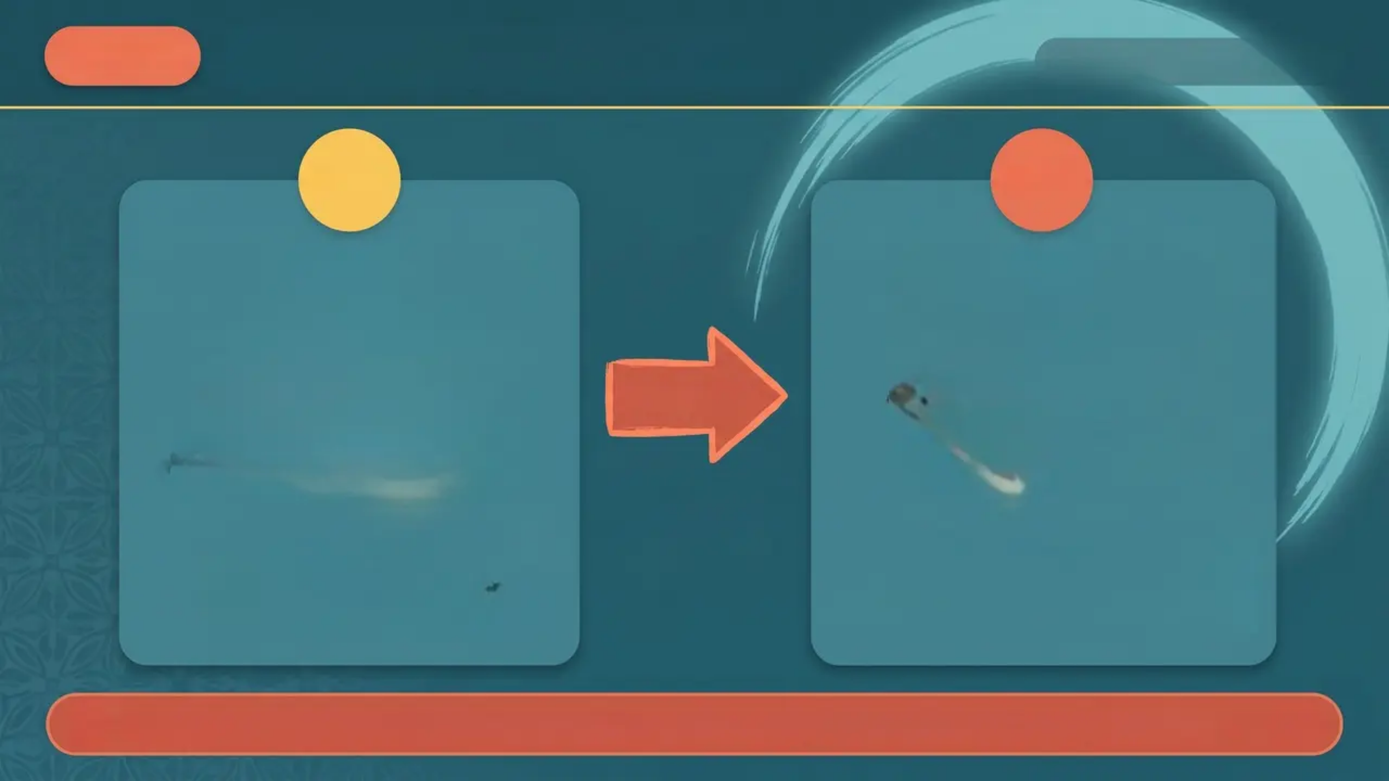
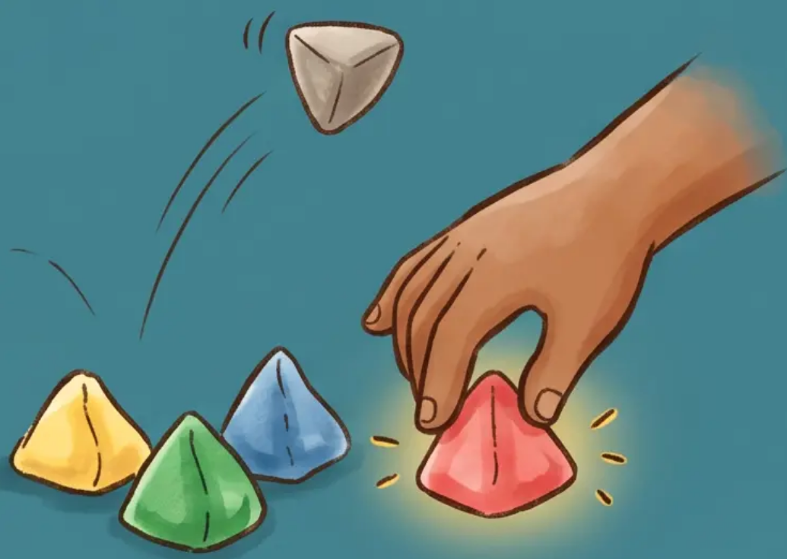
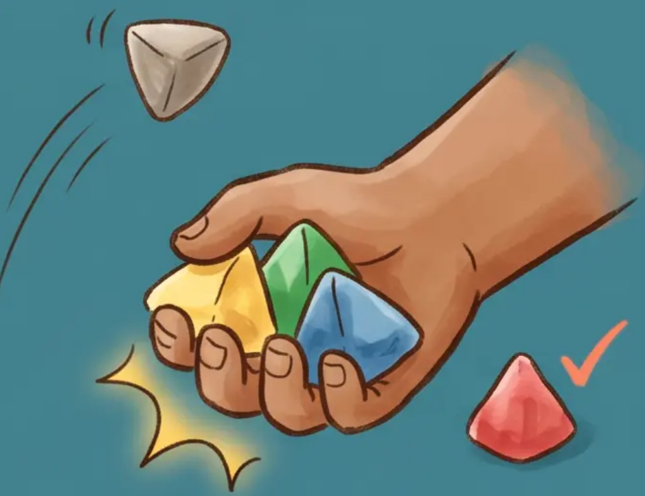



LEVEL 3
Pick One, Then Three
*Step-by-step challenge*
STEP 1
STEP 2
**THEN**
*repeat with the rest*
Toss the buah upward Grab one stone quickly Catch the buah!
Toss the buah again Grab the remaining three stones Catch the buah!
The Challenge: Both steps must be completed without faulting — one drop means losing your turn!

Slide 7
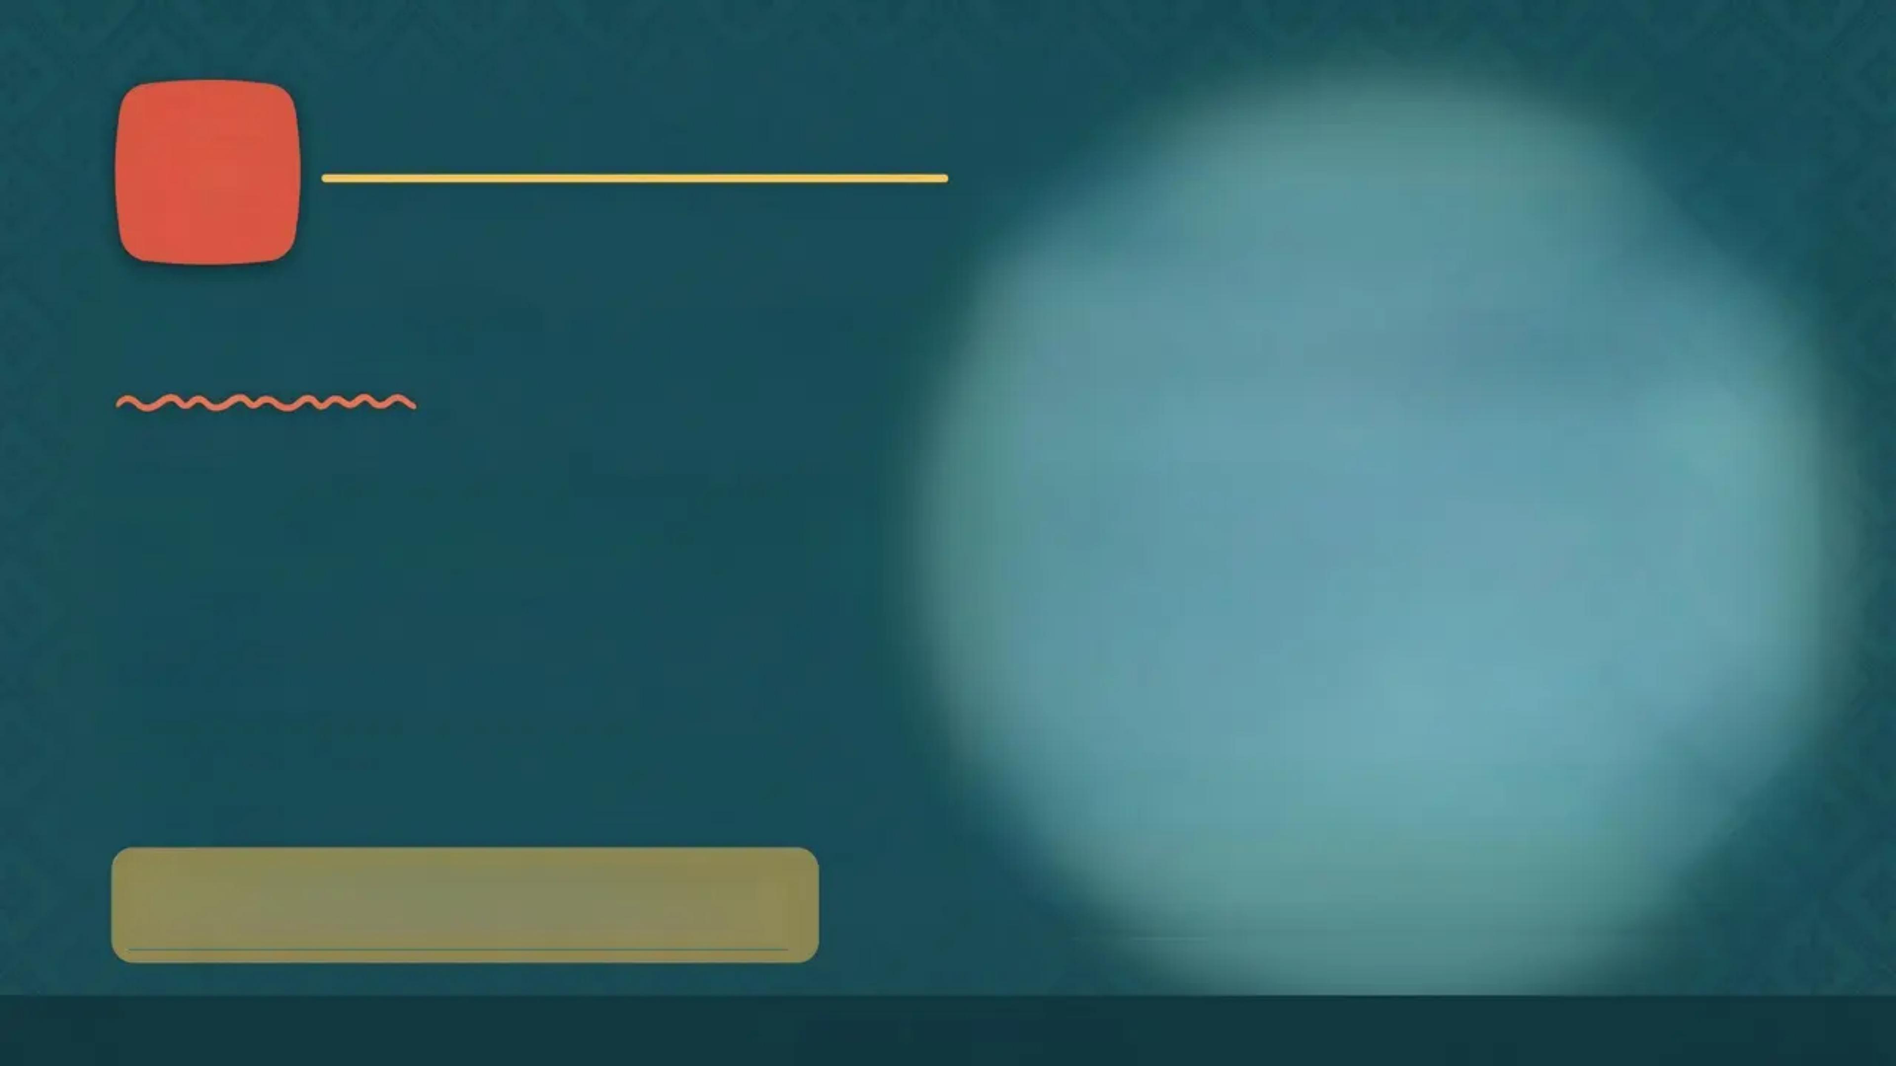

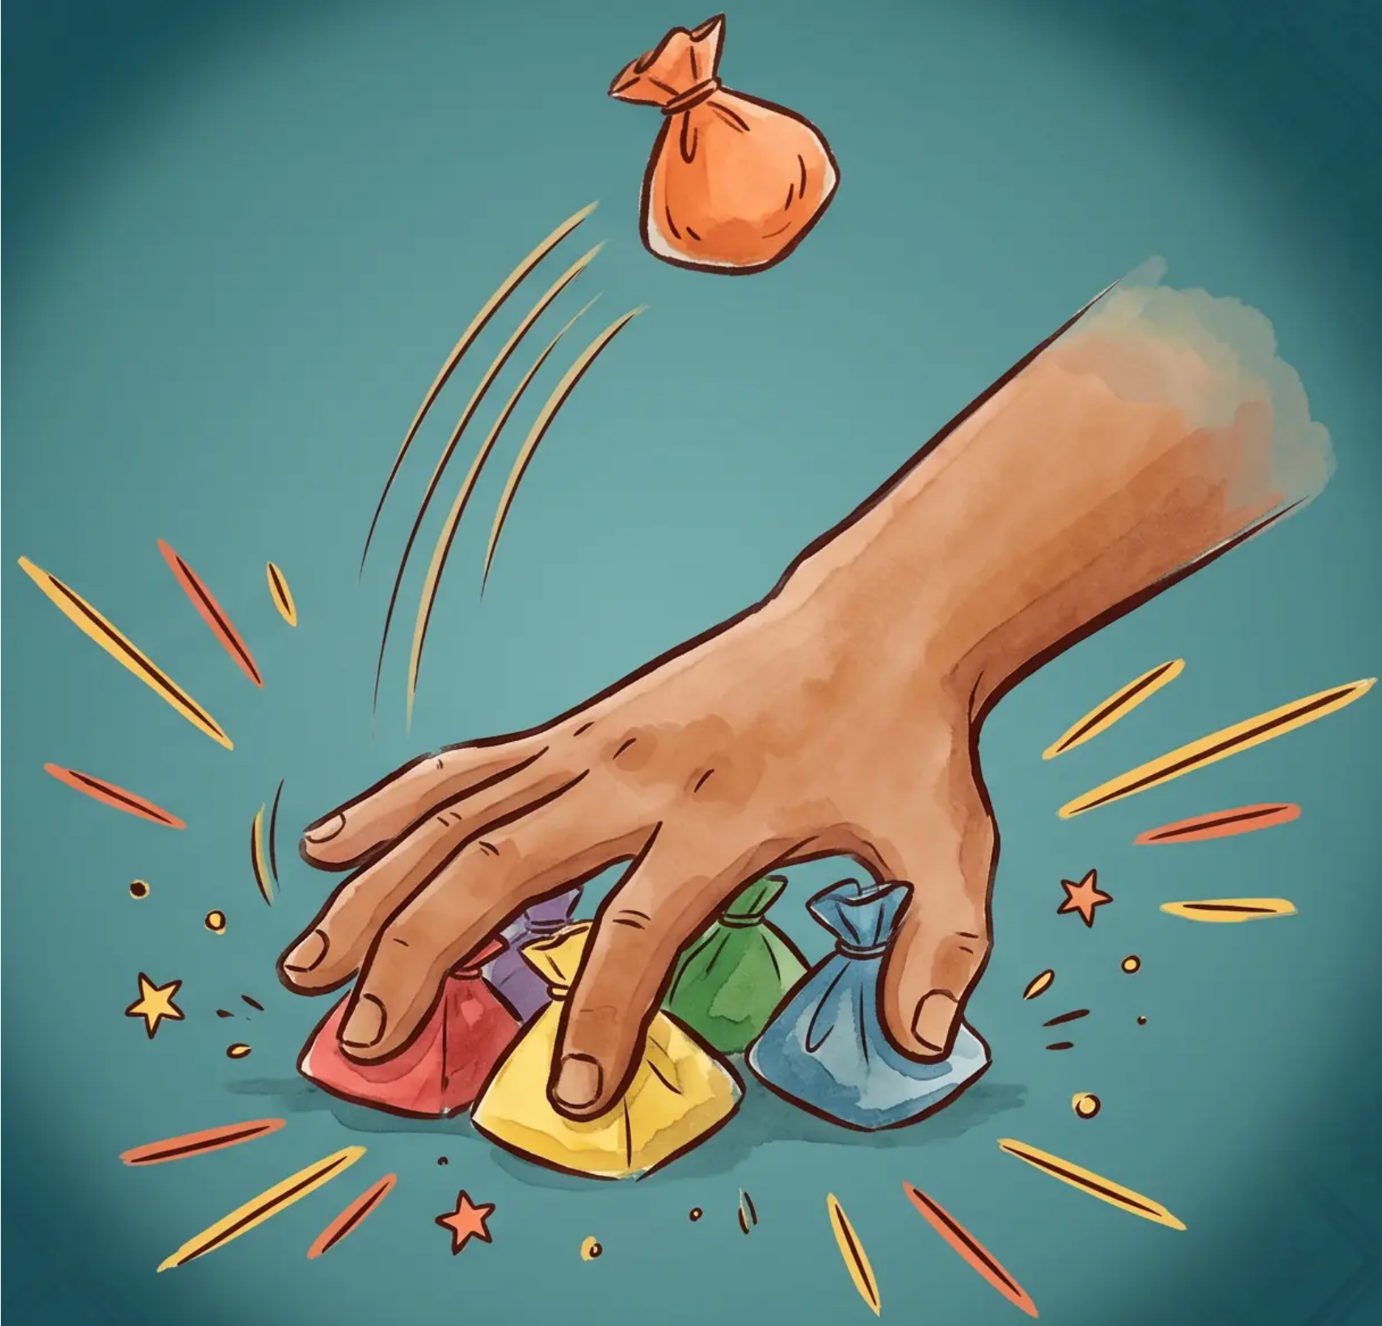


LEVEL
Pick Four Stones at a Time
OBJECTIVE
Sweep all four stones from the ground in one single fluid motion — then catch the tossing stone before it lands.
HOW TO PLAY
Toss the buah into the air
Sweep all four stones in one motion
Catch the buah before it hits the ground
⚡ The hardest pickup yet — speed and precision are everything!
Batu Seremban · Level 4 of 5

Slide 8

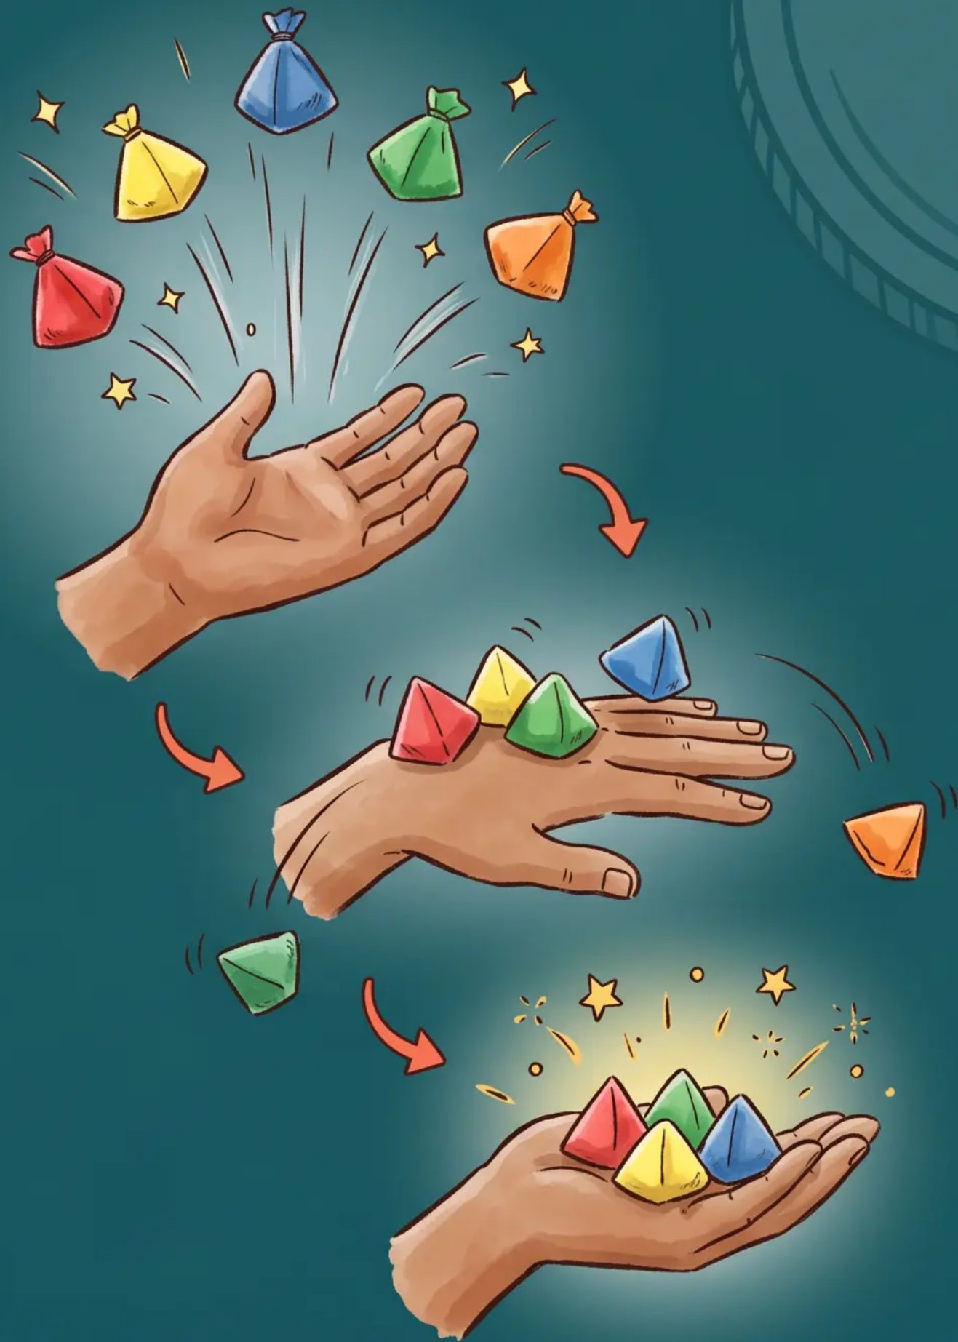


LEVEL 5 — Final Challenge
The Timbang Balancing
1
Toss All Five
Place all 5 stones in your palm, then toss them upward into the air.
2
Catch on the Back
Flip your hand quickly — catch as many stones as possible on the back of your hand.
3
Catch in the Palm
Toss the stones from the back of your hand upward again, flip back, and catch them in your palm.
The more stones you catch, the higher your score!
'The most skillful move in Batu Seremban'
08 / 10

Slide 9
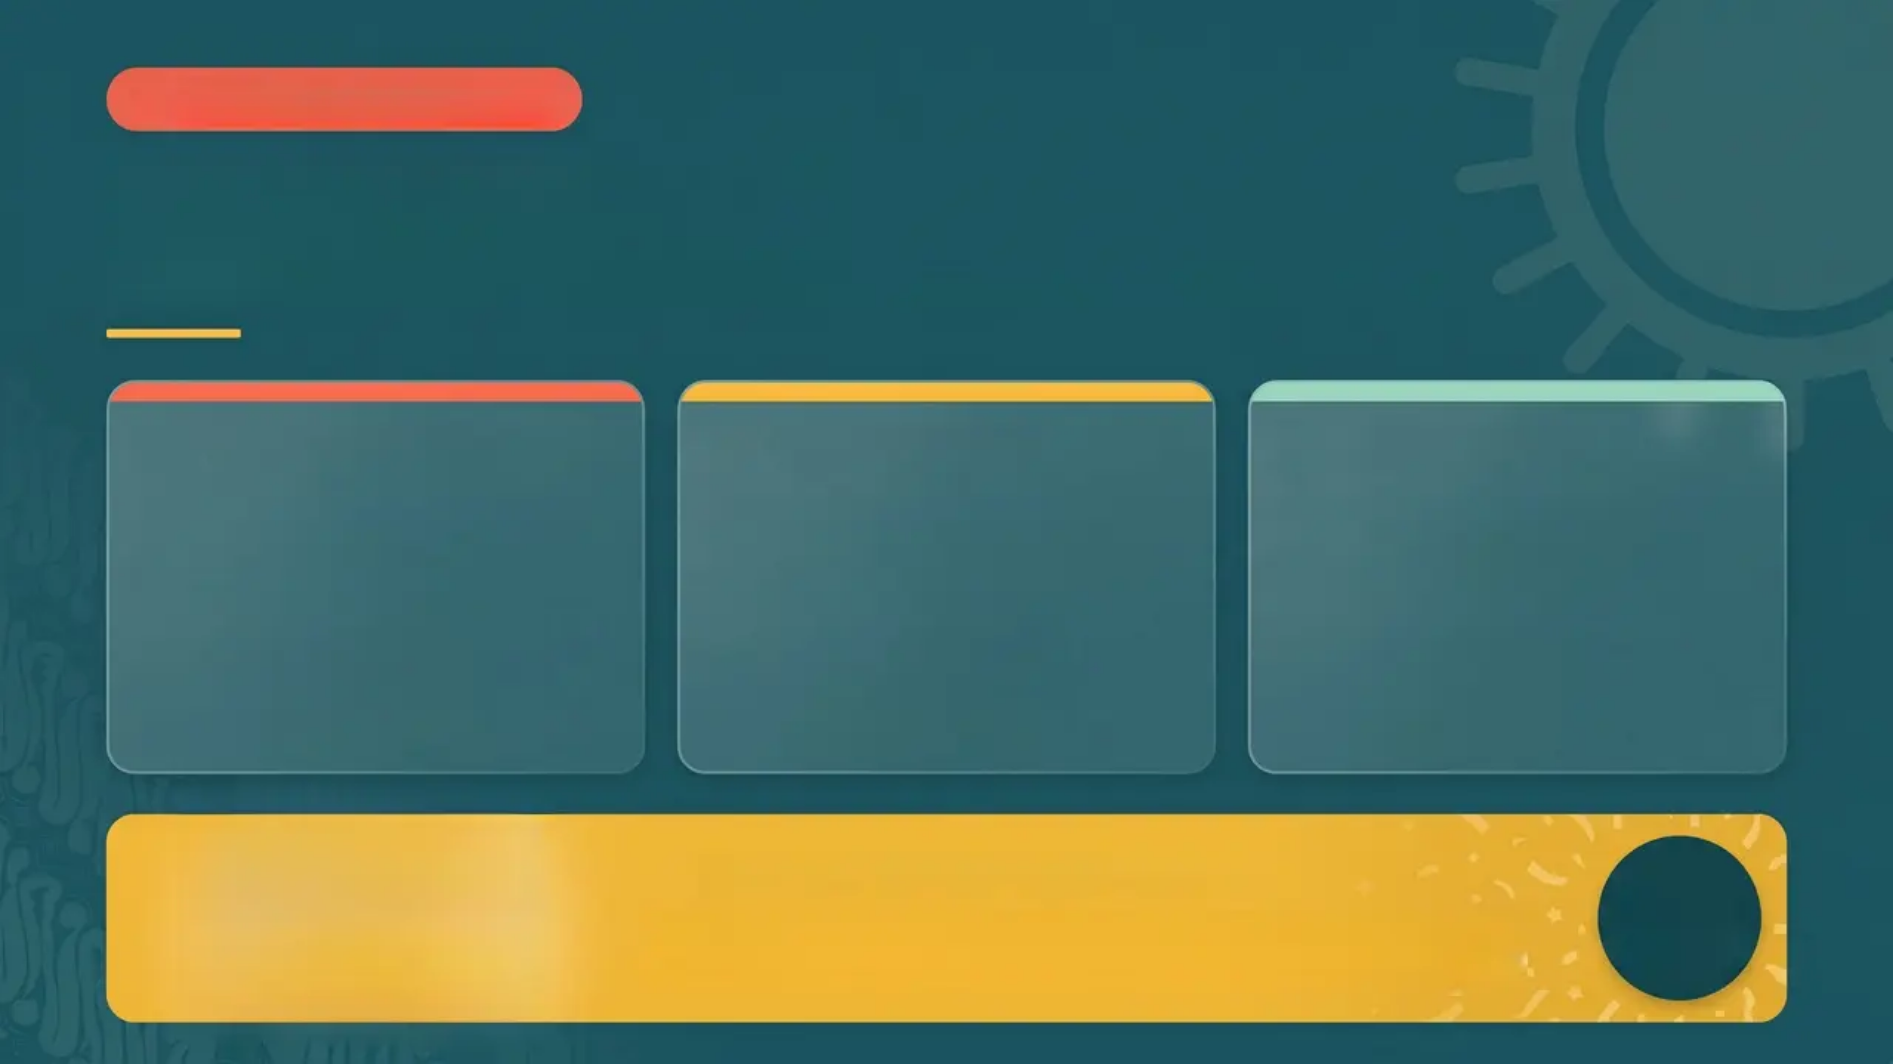

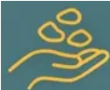

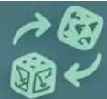
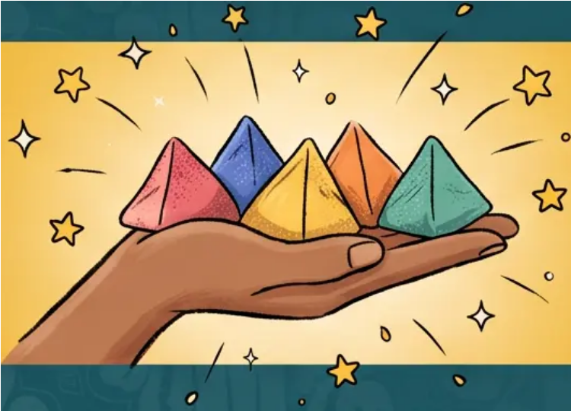

Level 5 • Timbang Only
Scoring System
*Points are earned during the Timbang round — the ultimate test of skill*
How to Score
How to Win
Variations
Each stone caught on the back of the hand and then successfully caught back in the palm earns points.
The player with the highest cumulative points after all rounds wins. First to reach the target score wins!
Some groups play with 1 point per stone instead of 2. Agree on the rules before the game begins!
2 pts
50 pts
1 pt
per stone caught
example target score
alternate scoring
Perfect Round Bonus!
10 pts
Catch all 5 stones during Timbang for a perfect round — an extraordinary feat worth celebrating!
(or maximum score)

Slide 10
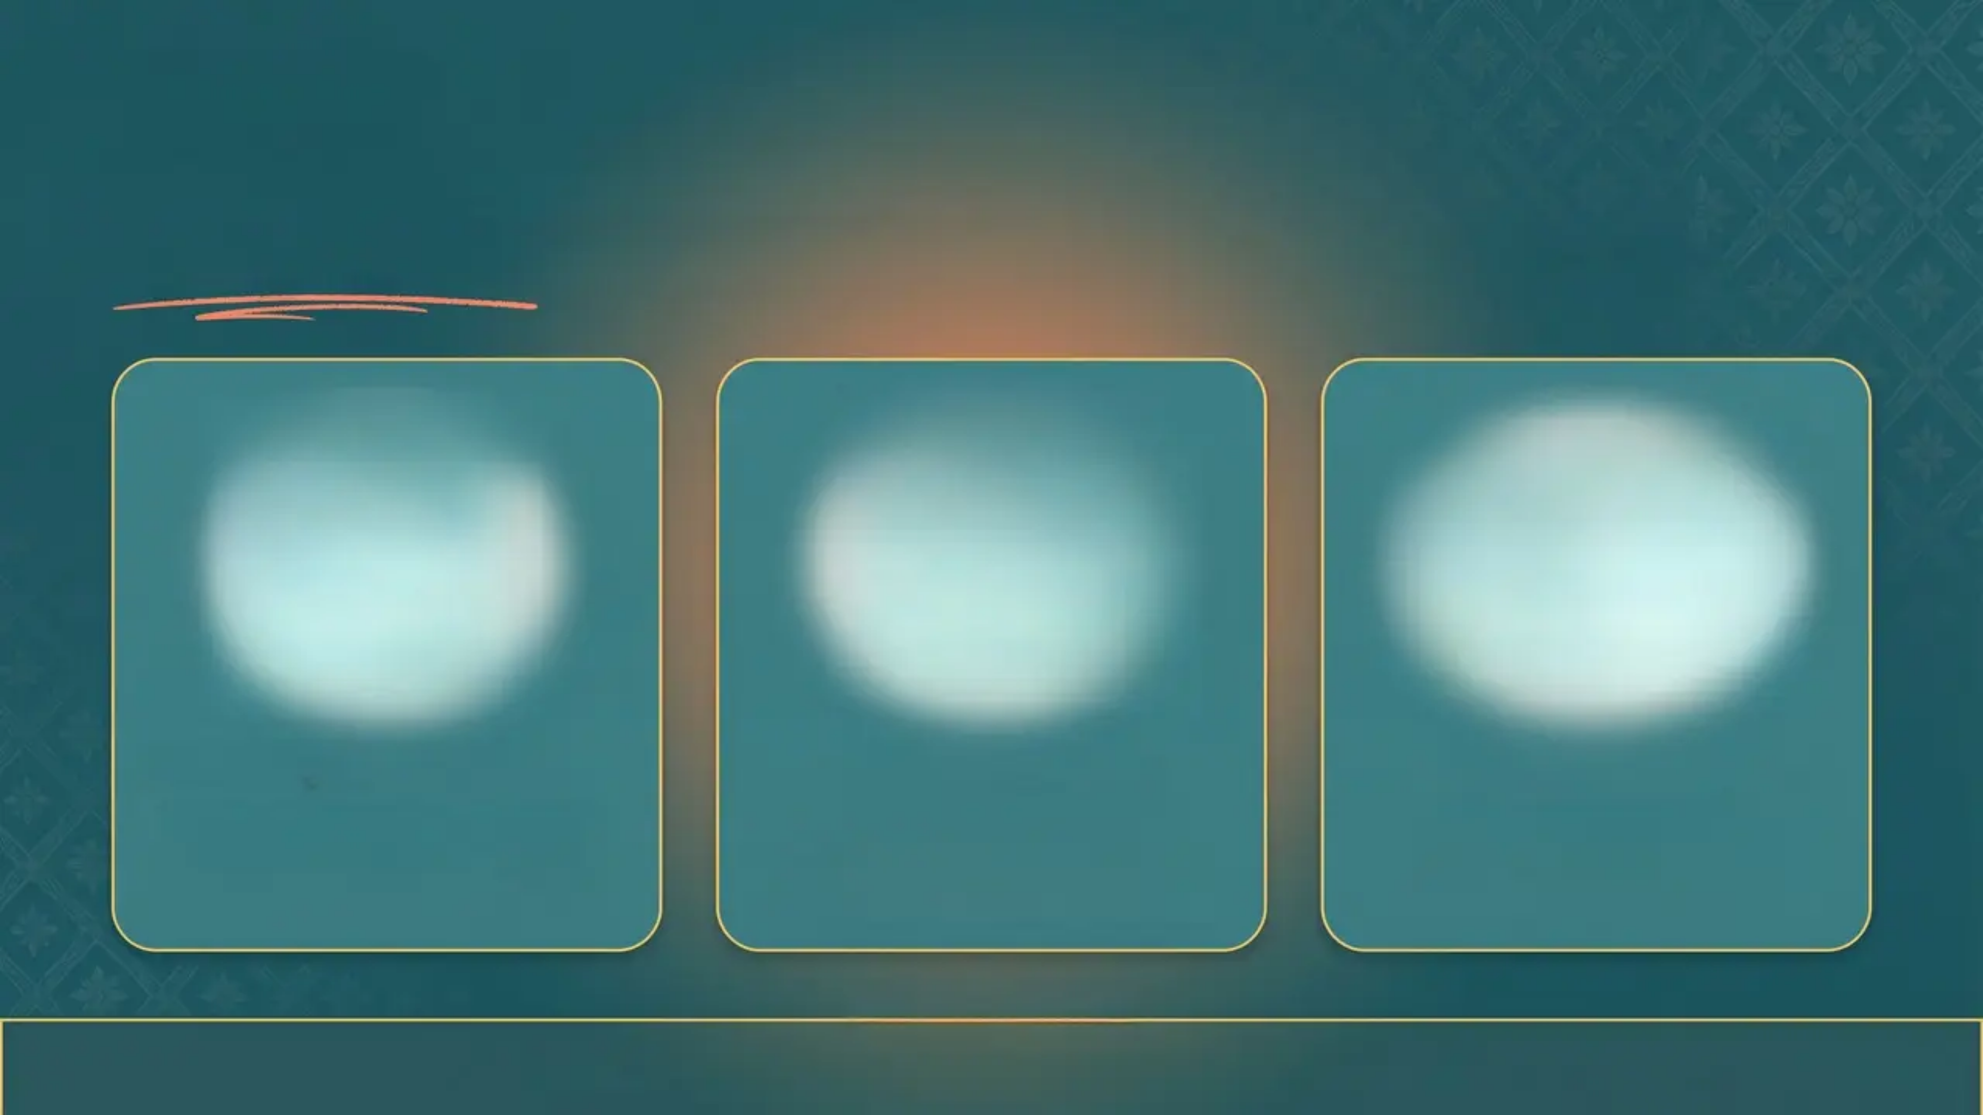
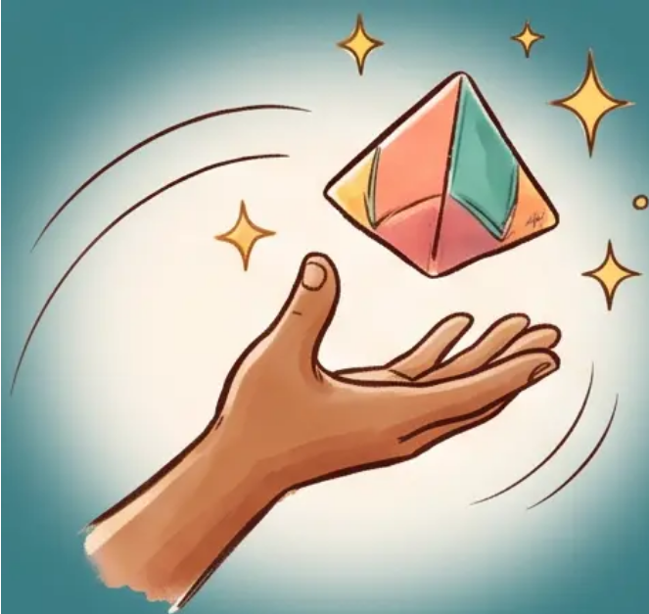
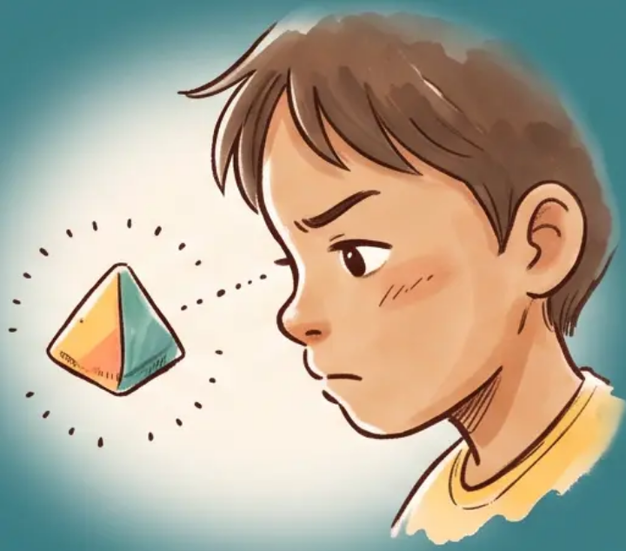
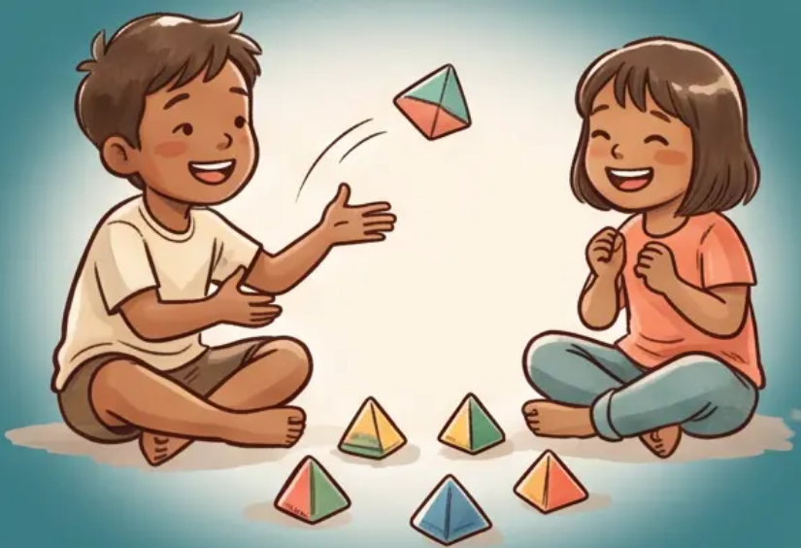

• WHY PLAY? •
Benefits of the Game
More than just a game — a timeless tradition that sharpens the mind and warms the heart.
Hand-Eye Coordination
Concentration
Social Bonding
Precise timing and quick reflexes develop naturally with every toss and catch.
Every round demands intense focus — training the mind to stay sharp and present.
A screen-free way to connect with friends and family across generations.
“A game played with the hands, remembered with the heart.”
Page 10 of 10

